Slide 1

Project Title - Healthcare Analytics for Doctor Visits
AICTE Student ID: STU6a59002fa26dd1784217647
Student Name: Sudhanshu Tripathi

Slide 2

PROBLEM STATEMENT
Why do some people visit a doctor more often than others?
The primary objective is to analyze patient-related data to identify meaningful patterns driving doctor visit frequencies.
This involves investigating how age, health condition, income, and chronic conditions influence healthcare utilization.

Slide 3
Project Description
Analyzed a comprehensive healthcare dataset consisting of 5,190 patient records across 13 distinct variables.
Evaluated variables categorized under Personal Information, Financial Information, Health Information, and Healthcare Support.
Performed end-to-end data processing, including removing non-essential identifiers (Unnamed: 0), followed by Univariate, Bivariate, and Multivariate visualizations to extract actionable insights.

Slide 4

WHO ARE THE END USERS?
Hospitals & Clinic Administrators: To anticipate patient inflow and resource requirements based on chronic illness trends (nchronic, lchronic).
Health Insurance Providers: To evaluate healthcare usage patterns among patients carrying private insurance coverage (private).
Public Health Policymakers: To assess the effectiveness and utilization of free healthcare support programs (freepoor, freerepat) by lower-income demographic groups.

Slide 5

Technology Used
Programming Language: Python 3
Data Manipulation: Pandas, NumPy
Data Visualization: Matplotlib, Seaborn
Environment: Google Colab / Jupyter Notebook

Slide 6
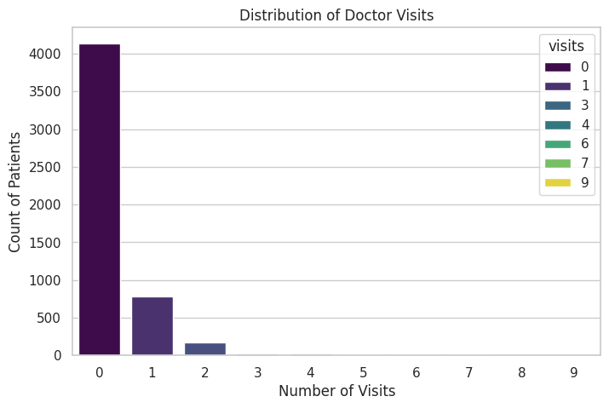
RESULTS
Doctor Visits Distribution
The univariate analysis reveals a right-skewed distribution, indicating a significant majority of individuals recorded zero doctor visits during the monitored period.
Github Link

Slide 7
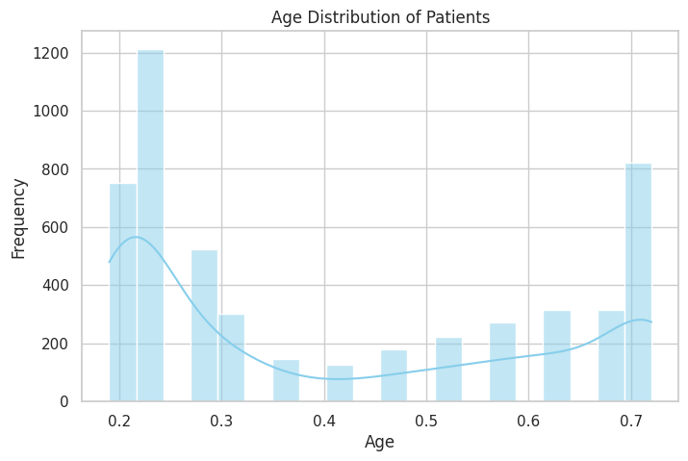
RESULTS
Gender Trends
Bivariate analysis indicates that females generally maintain a slightly higher average frequency of doctor visits compared to males.
Github Link

Slide 8
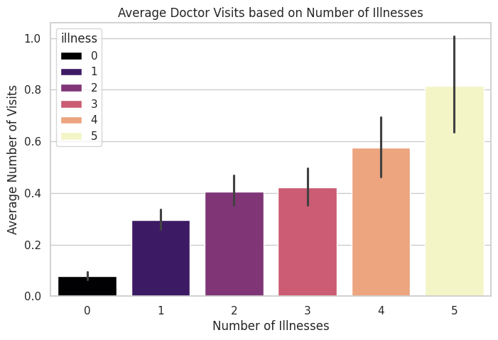
RESULTS
Impact of Illness
The bar chart demonstrates a direct positive trend: as the number of reported illnesses increases, the average number of doctor visits rises proportionally.
Github Link

Slide 9
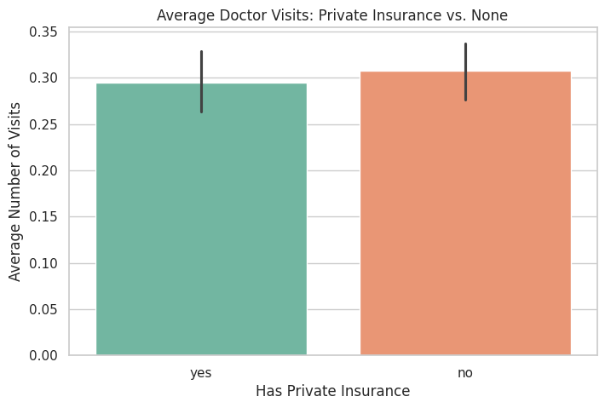
RESULTS
Healthcare Support
Patients with private healthcare coverage exhibit distinct visit patterns, highlighting the role of financial safety nets in medical accessibility.
Github Link

Slide 10
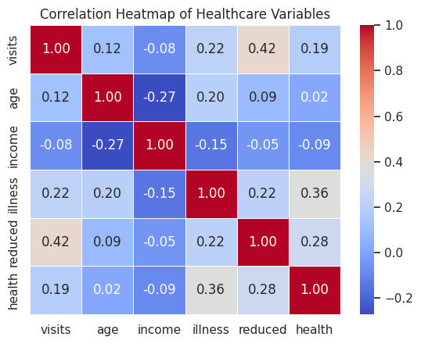
RESULTS
Correlation Heatmap
The multivariate heatmap maps the correlations between continuous health variables, specifically linking the number of reduced activity days with higher visit rates.
Github Link

Slide 11
Thank you
.
.

